Slide 1
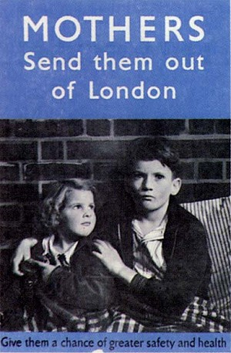
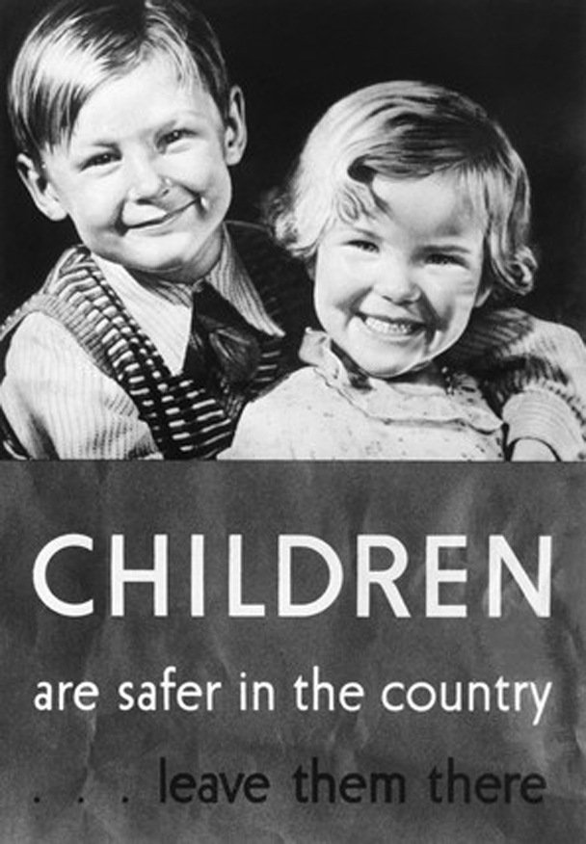
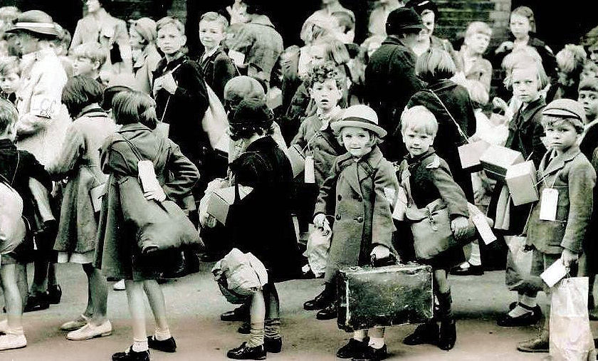


The War That Saved My Life
Informative Poster:
Surf the Net to find 5 websites that others might check out before or after they read the book so they will know more about the book’s setting and time period. Make sure to incude details about each website.
written by Kimberly Brubaker Bradley
Kim Johnson - Literature Project #9
Details for the Links of Interest:
Operation Pied Piper: The Evacuation of English Children During World War II - One of the most, if not the most, emotionally wrenching decisions made by the British government during World War II was its decision to relocate its children out of urban centers to locations where the risk of bombing attacks was low or non-existent. Called Operation Pied Piper, millions of people, most of them children, were shipped to rural areas in Britain as well as overseas to Canada, South Africa, Australia, New Zealand, and the United States. Almost 3 million people were evacuated during the first four days of the operation, making it the biggest and most concentrated population movement in British history.
Evacuees in World War Two - The True Story - As bombing raids attacking Britain’s cities increased during World War Two, thousands of children were uprooted from their families and sent to the safety of the countryside. Many found, however, that life away from home was no picnic.
Why were Children Evacuated? -People expected cities to be bombed, as enemy planes tried to destroy factories. But bombs would hit homes and schools too, so children would be in danger. The government tried at the start of the war to “empty the cities” of children and mothers. This was “evacuation” to protect them from air raids. The plan was put into action in September 1939. About 800,000 children left their homes.
How the Children Coped with a New Life -Children were massively affected by World War Two. Children had to endure rationing, gas mask lessons, living with strangers, and much more. Children accounted for one in ten of the deaths during the Blitz of London from 1940 to 1941.
Evacuation of Children during the World War Two -This is a mixture of photos and video clips of children being taken out of London during World War Two. It is approximately 3:29.
Website and Video Links of Interest
1
http://www.defensemedianetwork.com/stories/operation-pied-piper-the-evacuation-of-english-children-during-world-war-ii/
Image Title: An Evacuation Poster
Source: http://www.primaryhomeworkhelp.co.uk/war/images/posters/evac.jpg
Date Retrieved:October 20, 2016
2
http://www.bbc.co.uk/history/british/britain_wwtwo/evacuees_01.shtml
3
http://www.bbc.co.uk/schools/primaryhistory/world_war2/evacuation/
4
http://www.historylearningsite.co.uk/world-war-two/children-and-world-war-two/
Millions of British city children were evacuated to safer places during the WWII. Some hated living away from their families – others didn't want to go home again.
In the book, The War That Saved My Life,
Ada and Jamie are evacuated from London to the countryside
and ends up
living with a
woman named Susan.
5
https://www.youtube.com/watch?v=voUe1WFBD9Q
Image Title: Evacuation Poster WWII
http://liverpoolblitz70.co.uk/wp-content/uploads/2011/01/evacuation-poster-wwII.jpg
Date Retrieved: October 20, 2016
Newbery Honor
Award
2016
Childhood and Evacuation Photo Gallery and Stories
http://www.bbc.co.uk/history/ww2peopleswar/categories/c1162/
Title of Image: World War 2 Evacuees
Source: swanbournehistory.co.uk
Date Retrieved: October 20, 2016
Author:
Kimberly Brubaker Bradley
Image Title: Kimberly Brubaker Bradley
Source: http://static1.1.sqspcdn.com/static/f/601505/26848920/1455106186673/2016-02-10-WarSavedMyLife-v2-1500.jpg?token=x6i4fMeRQ36bGKrWRaqzMCnutfY%3D
Date Retrieved: October 20, 2016

